Slide 1
Drilling Dynamics – Numerical Simulation Internship
June 2024

Slide 2
Purpose
Premature PDC Bit failure
Violent bit motion and bit-rock interaction (bit whirl and stick-slip)
Confusion in understanding of PDC bit dynamics
Lack of technological development

Slide 3
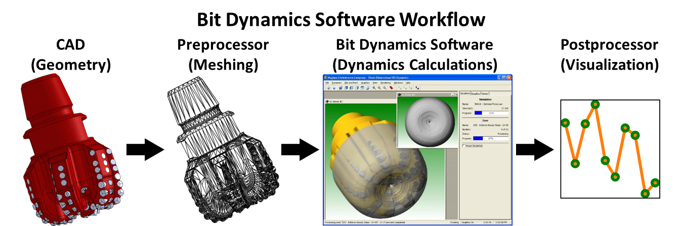
Objectives
Create a model simulating bit dynamics
Adapt for different bit design
Feed model results into postprocessor (built by Allan)
Visualize and analyze results
Develop synthetic data for calibrating algorithms

Slide 4
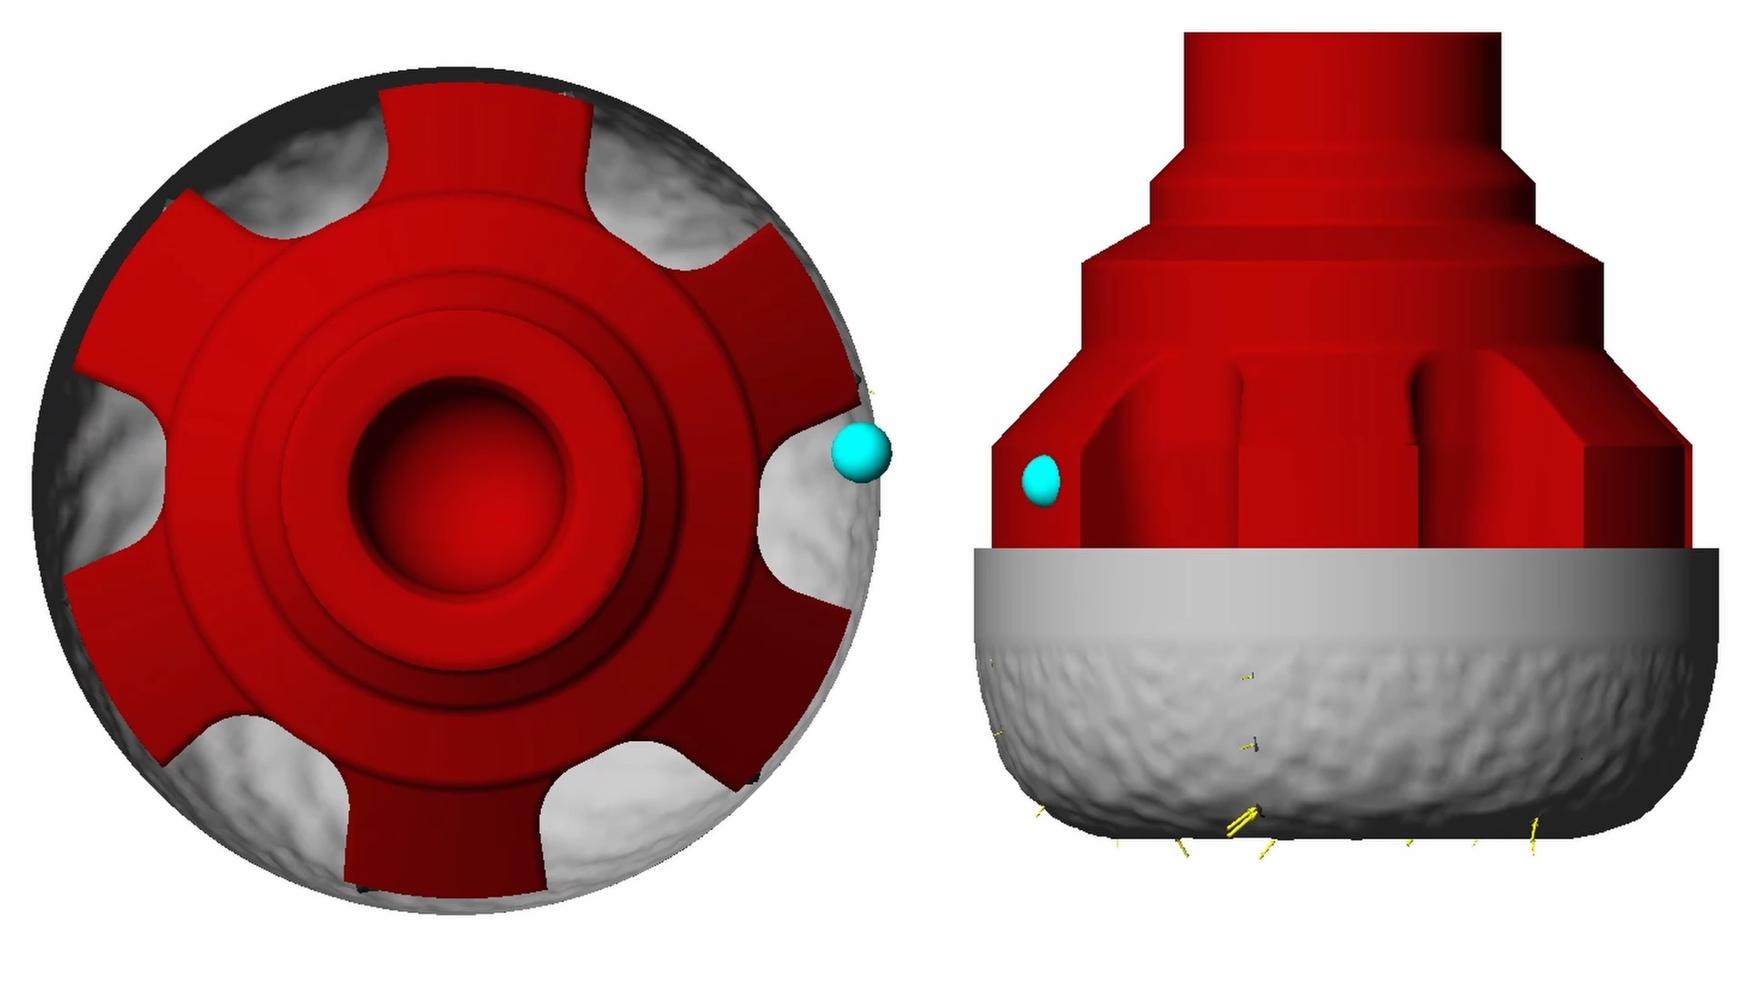
Model Demonstration

Slide 5
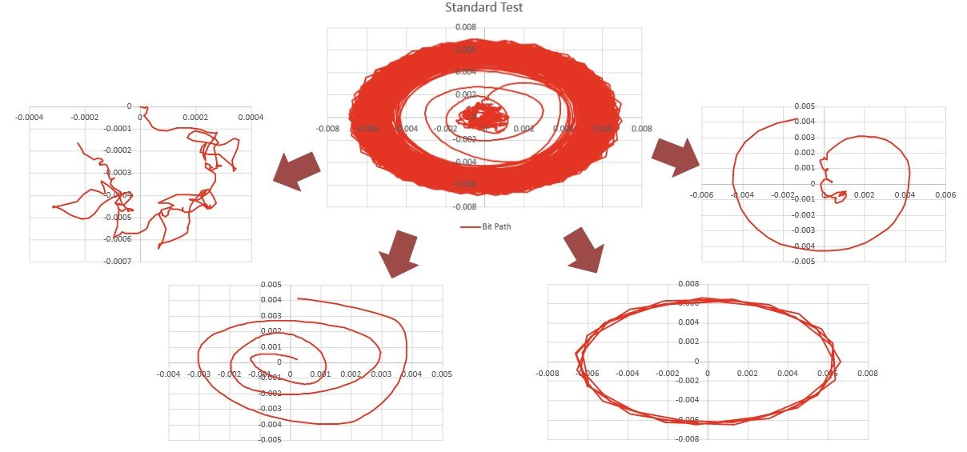
Postprocessing Concept

Slide 6
Project End Analysis
Examine outputs comparing model results and bit performances
Documentation
Write research paper on project feats and efforts
Compare/contrast with historic research and past conclusions
Publish paper to SPE

Slide 7
Challenges
Challenge of developing new ideas
Narrow time window
Numerous critical parts to be developed
High chance of delays
We don’t know what we don't know
Personal Education
Software (including original model simulator)
Pre-/Post- processors
Coding/compiling
Researching and understanding past work

Slide 8
Thank you Questions?
谢谢 问题?

